Slide 1
Gender Responsive Budgeting (GRB) in Australia
Team member:
Xi Tang Lin (Co), Zhangfan Huang, Solbee Kim, Xinyu Yan
EPPS 6302

Slide 2
CONTENTS
Outline
1
Research Background
2
Research Questions
3
Methods & Results
4
Conclusion & Discussion

Slide 3
PART 01
Research Background

Slide 4
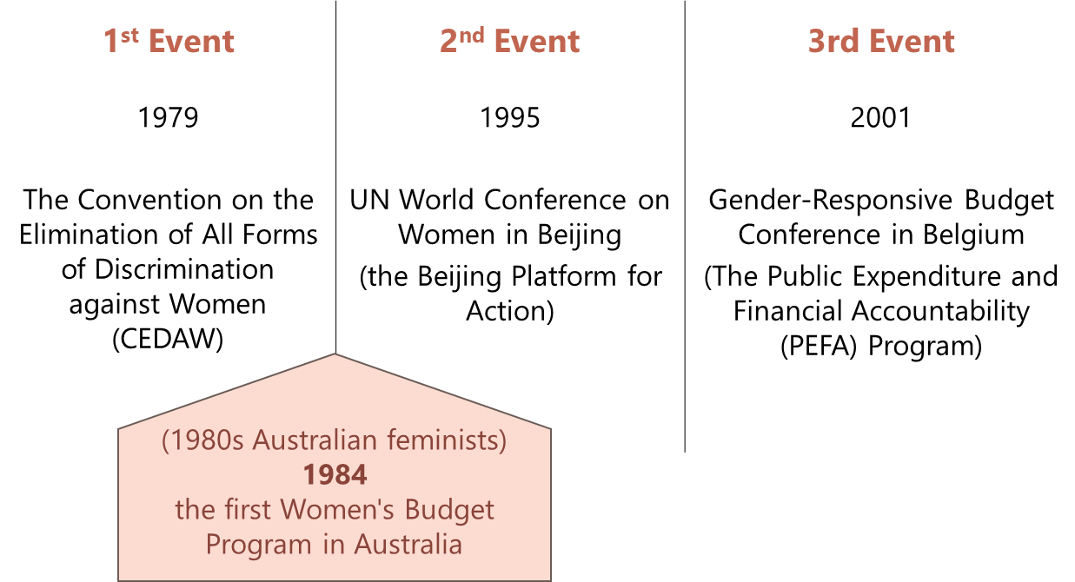
Research Background
International Development
Foundational Approaches
UN’s Sustainable Development Goals (SDGs)
- SDG 5 – Gender Equality
- SDG 10 – Reduced inequality
OECD: Gender equality in public life (2015)
Feminism: Gender Mainstreaming

Slide 5
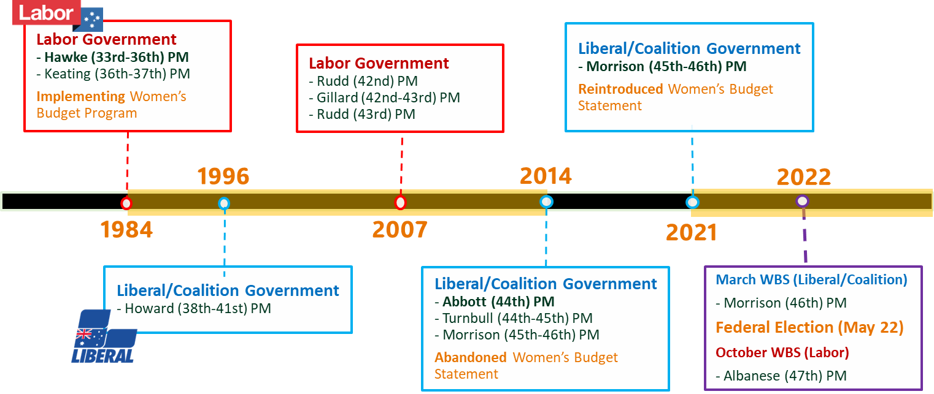
Research Background
History of Australian Gender-responsive Budgeting

Slide 6
PART 02
Research Design

Slide 7
Research Design
Research Questions
RQ 1. How have policy targets, program areas, and thematic priorities in the Women’s Budget Statements evolved between 1984 and 2025?
RQ 2. What is the relationship between changes in the Women’s Budget Statements’ topic focus and changes in the GII & HDI in Australia?
RQ 3. To what extent do shifts in the content and focus of the Women’s Budget Statements correspond with broader trends in gender equity, as measured by international indices?

Slide 8
Research Design
Data Sources
Women’s Budget Statement
International Indices
Total period: 1984 to 2013 and 2021 to 2025
Actual data: 32 Documents (Up to 300+ pages per document)
Missing Data for 2004 & 2007
Gender Inequality Index (GII, 1990+)
Human Development Index (HDI, 1990+)
Social Institutions and Gender Index (SIGI, 2009+)
SDG Gender Index (2013+)

Slide 9
Research Design
Data Sources
Gender Inequality Index (GII)
Human Development Index (HDI)
A composite index that measures the loss of human development due to gender inequality.
Three dimensions:
  Reproductive health: Maternal mortality ratio and adolescent birth rates.
  Empowerment: Percentage of seats held by women in parliament and education levels for women versus men.
  Labor market participation: Labor force participation rates for both sexes.
Score: Ranks from 0 to 1, where 0 is perfect gender equality and 1 is the highest level of inequality.
A composite statistic from the United Nations Development Programme (UNDP) that measures a country's average achievements.
Three key dimensions:
  Health: Measured by life expectancy at birth.
  Education: A combined index of expected years of schooling for children and mean years of schooling for adults.
  Standard of living: Measured by gross national income per capita (PPP US$).
Score: Ranging from 0 to 1, uses a geometric mean to combine indicators for life expectancy, expected and mean years of schooling, and gross national income per capita. A higher score indicates a higher level of human development.

Slide 10
Research Design
Data Sources
Social Institutions and Gender Index
SDG Gender Index
Measures discrimination in laws, norms, and social practices.
Focuses on family, violence, resources, civil liberties, and son bias.
Scores countries from 0 (low) to 1 (high discrimination).
Tracks gender equality outcomes linked to SDG 5 (Achieve Gender Equality and Empower All Women and Girls)
Includes education, health, economic, political, and legal indicators.
Provides a global benchmark for progress and gaps.

Slide 11
Research Design
Data Processing
Creating the Corpus, Tokenization, and Spellchecking
Created a quanteda corpus from the documents using readtext.
Tokenized the corpus and performed initial cleaning.
Identified unique tokens and find misspellings using hunspell.
Generated automatic suggestions and performed manual corrections on the 800 most common errors. (with the help of AI)
Replaced misspelled tokens and exported data into a csv for analysis in Python.

Slide 12
PART 03
Results

Slide 13
Result: Textual Analysis
Method 1: Textual Analysis
Two computational text analysis techniques
  Topic Modeling
  Word Frequency Analysis
Examine the evolution of Australia’s WBS between 1984 and 2025.
Capture both the latent thematic structures and the explicit linguistic patterns
Characterize how GRB has been conceptualized and framed under different political, institutional, and social contexts

Slide 14
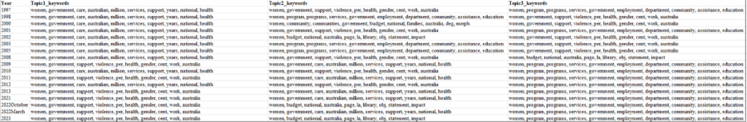
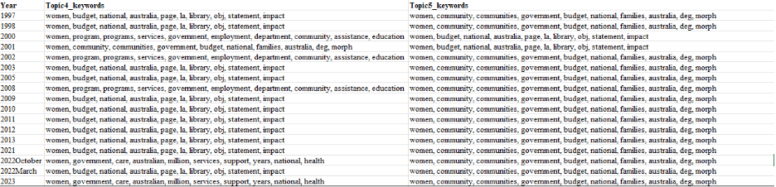
Result: Textual Analysis
Topic Modeling (LDA)
Identifies underlying themes (e.g., health, education, social protection, family)
Temporal trend: Tracks thematic shifts over time (e.g., “economic participation”--market-oriented vs. “social protection”--welfare-oriented framing)

Slide 15
Result: Textual Analysis
Topic Modeling (LDA)
Across the entire period, topics consistently reflects the government’s emphasis on women’s access to social services—including care, health, and national support programs—indicating that foundational welfare-oriented language has remained a core component of WBS discourse.
Topic theme:
Gender-based violence, women’s safety, and health-related protection: salience increasing during the late 2000s and again after 2021.
The post-2021 period shows a clear reintensification of discourse around women’s safety and social services, suggesting that the reinstated WBS responds directly to contemporary political pressures and public concern about gender inequality.

Slide 16
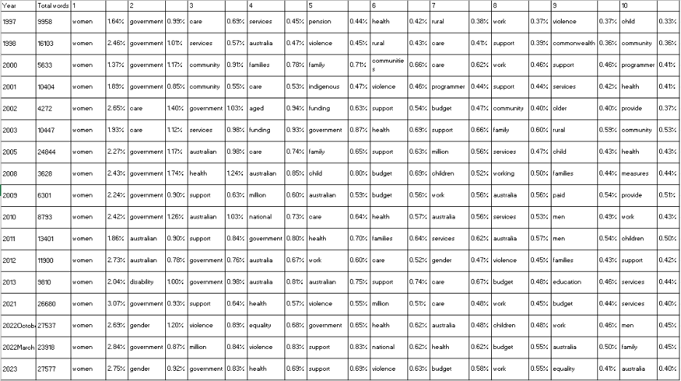
Result: Textual Analysis
Word Frequency Analysis
Direct measure of the visibility and prioritization of gender-related discourse
Uses term frequency-inverse document frequency (TF-IDF) weighting to adjust for differences in document length and overall term usage
reveal how the lexical prominence of specific concepts has evolved

Slide 17
Result: Textual Analysis
Word Frequency Analysis
Patterns discovered
The frequency of “violence” displays a distinct temporal pattern.
  It is present sporadically in the late 1990s and early 2000s but increases substantially from 2008 onward, and especially after 2021.
  The resurgence of “violence” as a top word—from 2021 through the 2022 and 2023 statements—marked by national inquiries, public protests, and heightened visibility of gendered violence cases.
The early 2000s also show increases in terms like “community,” “families,” and “children.”
  The Howard-era WBS adopted a more community- and family-oriented framing of gender equity, consistent with conservative policy agendas emphasizing household-level supports, regional targeting, and localized service delivery rather than system-level feminist reforms.
Terms such as “pension,” “indigenous,” and “rural” appearing in the top ranks (e.g., 1997, 2000, 2001, 2008)
  indicate selective focus on specific population groups within the broader umbrella of women’s programs.

Slide 18
Result: Regression
Method 2: Regression Objectives
Objective 1
The regression analysis aims to quantitatively evaluate the relationship between the Key Words of the Women’s Budget Statements (WBS) and the ndex (GII & HDI) from certain years.
Objective 2
This approach allows us to assess whether shifts in policy emphasis within the WBS are associated with changes in gender-related index over time.
Objective 3
In addition, the analysis will examine whether these relationships differ under governments led by the Australian Labor Party and the Liberal Party of Australia.

Slide 19
Result: Regression
Regression Analysis
OLS Regression
Ordinary Least Squares (OLS) regression, we aim to establish empirical links between keywords frequency (captured through textual analysis) and GII score & HDI score index, offering evidence on how gender-oriented discourse translates into international index.
Year | gender | disability | aged | health | violence | equality | work | pension | family | community | indigenous | rural | child & children | parents | men | cares | leave | education | economic, tax, income | sexual
1997 |  |  |  | 42 | 37 |  | 37 | 44 |  |  |  | 38 | 33 |  |  | 69
1998 |  |  |  |  | 72 |  |  |  |  | 58 |  | 70 | 50 |  |  | 66
1999 |  |  |  |  |  |  |  |  | 84 |  | 22 |  |  |  |  | 35
2000 |  |  |  |  |  |  | 26
2001 |  |  |  | 43 | 48 |  | 40 |  |  |  | 49 |  |  |  |  | 55
2002 |  |  | 57 |  | 15
2003 |  |  | 43 | 72 |  |  |  |  |  |  |  | 62 | 39
2004
2005 |  |  |  | 106 |  |  |  |  | 162 | 91 | 94 |  | 107 |  |  | 183
2006
2007
2008 |  |  |  | 45 |  |  | 21 |  | 16 |  |  |  | 48 |  |  |  |  |  | 12
2009 |  |  |  |  |  |  | 35 |  |  |  |  |  |  |  |  |  | 47
2010 |  |  |  | 50 | 37 |  |  |  |  |  |  |  | 33 |  | 43 | 56
2011 |  |  |  | 94 | 50 |  |  |  | 86 |  |  |  | 67 |  | 67
2012 | 56 |  |  |  | 54 | 43 | 115 |  | 51 | 42 |  |  |  |  | 44 | 62
2013 |  | 98 |  |  |  |  | 39 |  |  |  |  |  |  |  |  | 66 |  | 45
2021 |  |  |  | 151 | 146 |  | 121 |  | 101 |  |  |  |  |  |  | 129
2022 | 330 |  |  | 172 | 245 | 187 | 127 |  |  |  |  |  | 133 |  | 123 | 123 |  |  | 103
2023 | 253 |  |  | 191 | 173 | 112 | 152 |  |  |  |  |  | 95 |  | 91 | 113 |  |  | 103

Slide 20
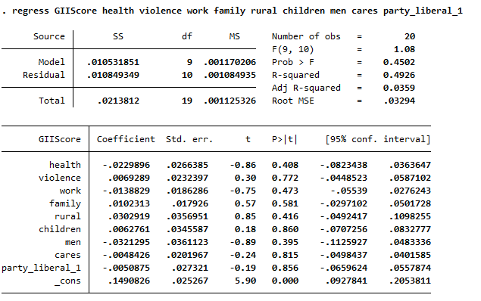
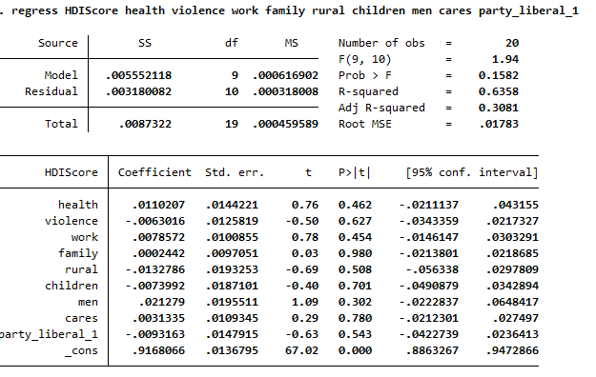
Regression Result: Key-Word frequency as Binary
Result: Regression

Slide 21
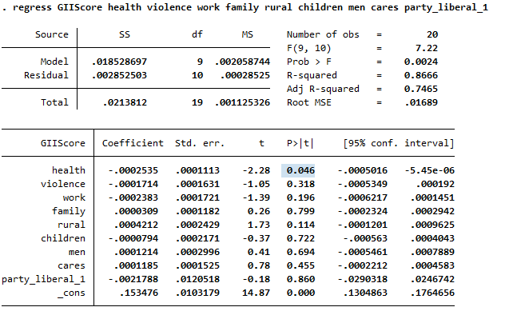
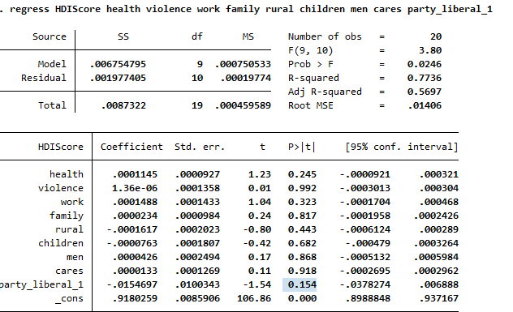
Regression Result: Key-Word frequency as Continuous
Result: Regression

Slide 22
PART 04
Conclusion & Discussion

Slide 23
RQ 1. How have policy targets, program areas, and thematic priorities in the Women’s Budget Statements evolved between 1984 and 2025?
Conclusion & Discussion
Core Continuous theme: Social Services
  Across the entire period, WBS consistently emphasized women’s access to care, health, and national support programs.
Increased Focus on Gender-Based Violence
  Mentions of violence increased significantly from 2008 and peaked after 2021.
Shifts in Framing During the Early 2000s
  Reflected a more conservative, localized, and household-oriented approach to gender equity.
Limited Emphasis on Economic Participation
  Labor market equality was not the central rhetorical focus across most years.
Discontinuation Period: 2014–2020
Reinstatement and Reintensification: Post-2021
  More institutionalized, metric-driven approach aligned with public accountability.

Slide 24
RQ 2. What is the relationship between changes in the Women’s Budget Statements’ topic focus and changes in the GII and HDI in Australia?
Conclusion & Discussion
Binary models
  No significant association
Continuous models:
  Overall linkages between keyword intensity and national outcomes are weak and selective.
  “Health” frequency is the only keyword significantly associated with GII (p = 0.046): health-focused discourse aligns more closely with shifts in gender inequality.
  Party change shows a marginal association with HDI (p ≈ 0.10): institutional or ideological differences may shape reporting emphasis and framing.
Overall
  WBS reflects evolving policy narratives but only weakly maps onto international gender equity trends.
  Specific themes (e.g., health) show alignment, but broader discourse shifts do not reliably predict national progress, highlighting gaps between communication, resource delivery, and social outcomes.

Slide 25
RQ 3. To what extent do shifts in the content and focus of the Women’s Budget Statements correspond with broader trends in gender equity, as measured by international indices?
Conclusion & Discussion
Text patterns partially align with movements in gender equality indicators, though links appear indirect and complex.
Overall, WBS serves as both a policy tool and a reflection of broader social and political priorities on gender issues in Australian context.

Slide 26
Conclusion & Discussion
Limitations
Missing Data
  Women’s Budget Statement: 2004 (Hard Copy only) & 2007 (Unidentified)
    The old documents were PDF files in image format
  International indices cover short time periods
Coverage of Selected Variables in International Indices
  GII: Maternal mortality ratio & adolescent birth rates; Percentage of seats held by women in parliament
  HDI: Expected years of schooling for children & mean years of schooling for adults.
Federal levels' WBS might not cover the details of gender-responsive policies.

Slide 27
Conclusion & Discussion
Future Research
Prefered Qualitative research
  Country-specific context
  Case study
State / Territory levels & Local levels of WBS in Australia
Other developing countries’ GRB reports & International Indices

Slide 28

Thank you!
Questions and Comments?
EPPS 6302

